Slide 1
Loops
Notes:
https://www.excel-easy.com/vba/create-a-macro.html

Slide 2
Table of Contents
Lesson overview
Single loop
double loop
Triple Loop
Do while loop

Slide 3

Lesson overview
Looping is one of the most powerful programming techniques. A loop in Excel VBA enables you to loop through a range of cells with just a few codes lines.

Slide 4
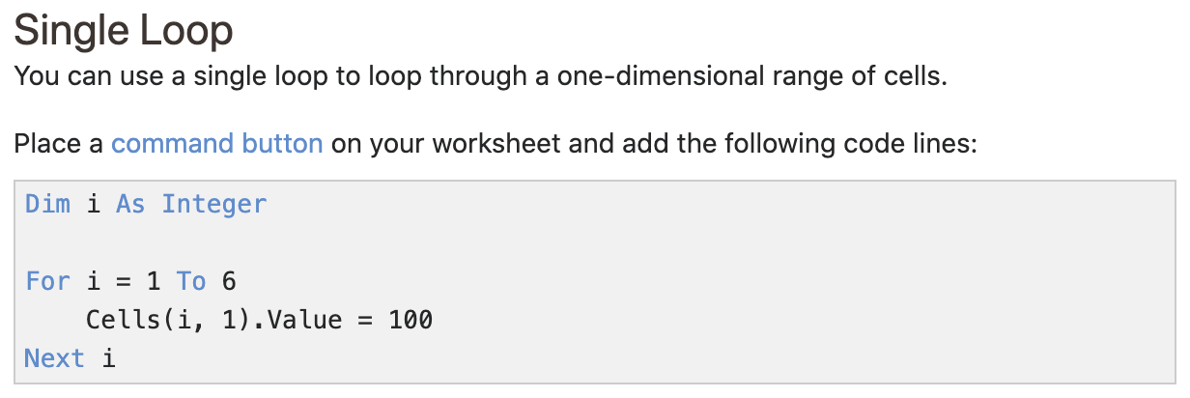
Single loop

Slide 5
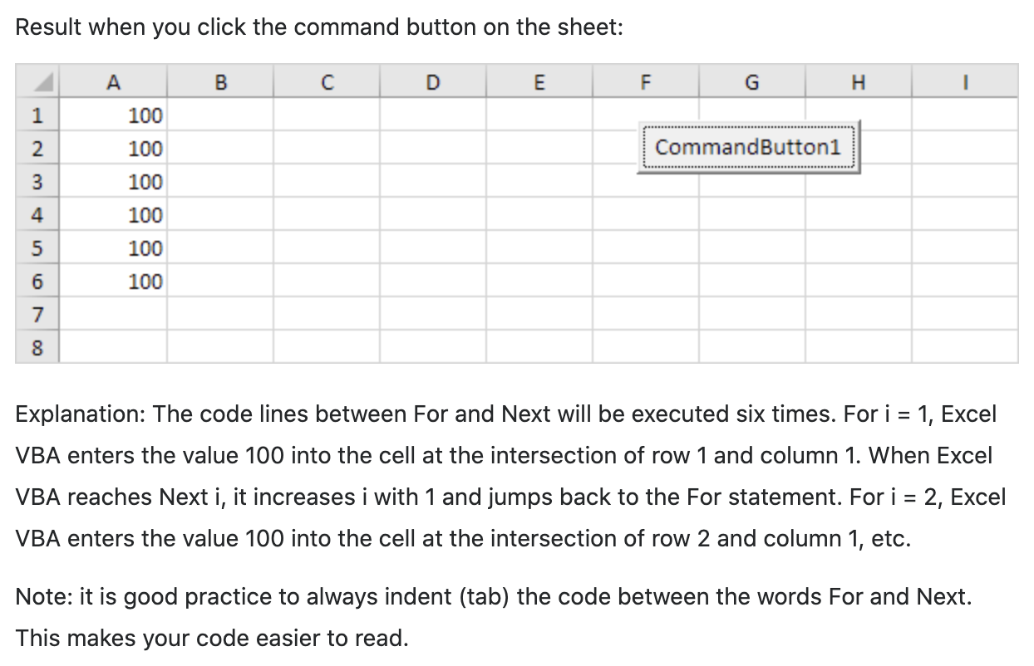
Single loop

Slide 6
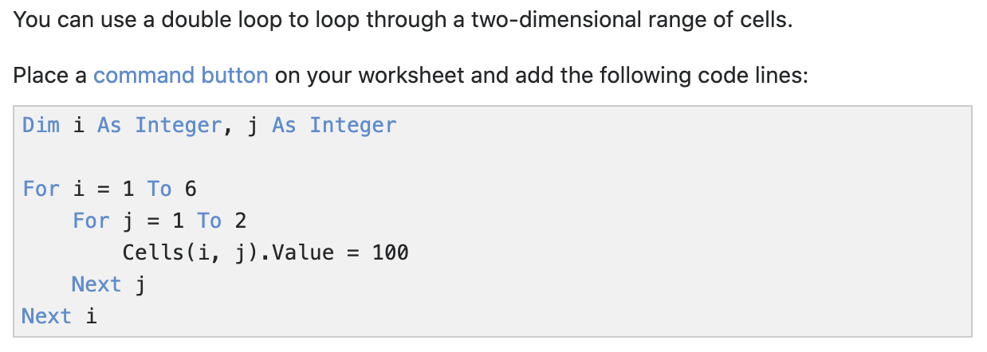
double loop

Slide 7
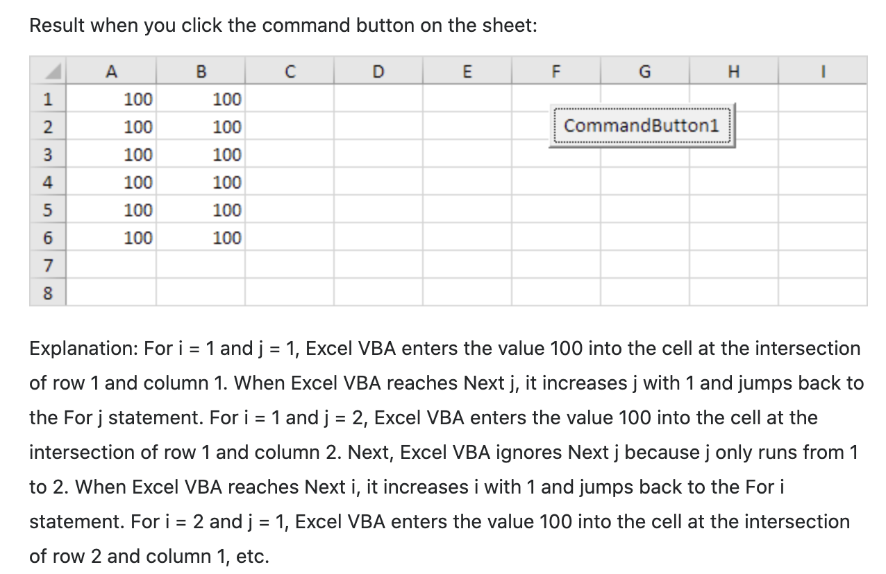
double loop

Slide 8
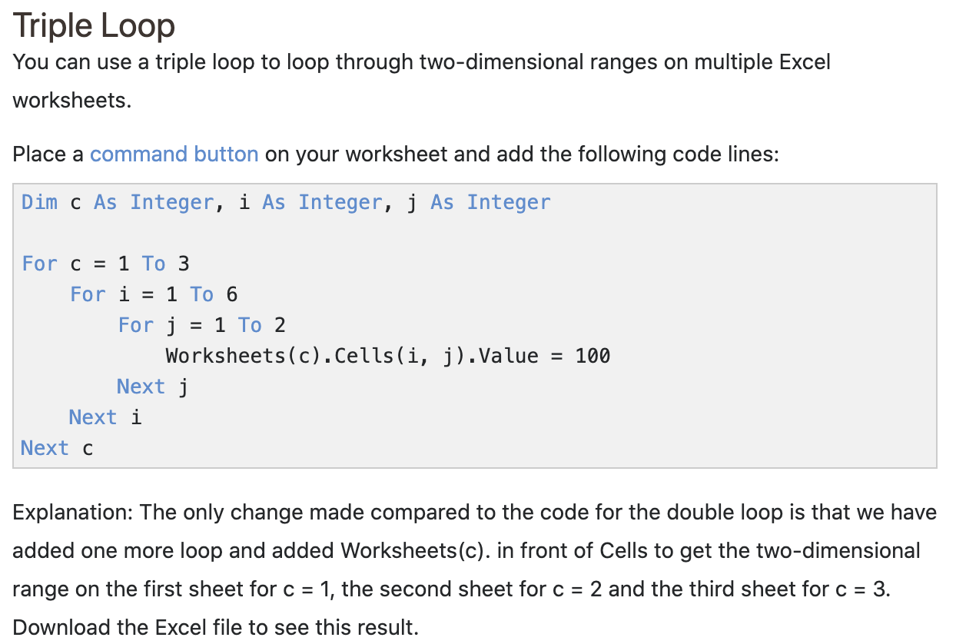
Triple Loop
*Not tested, just for knowledge purposes

Slide 9
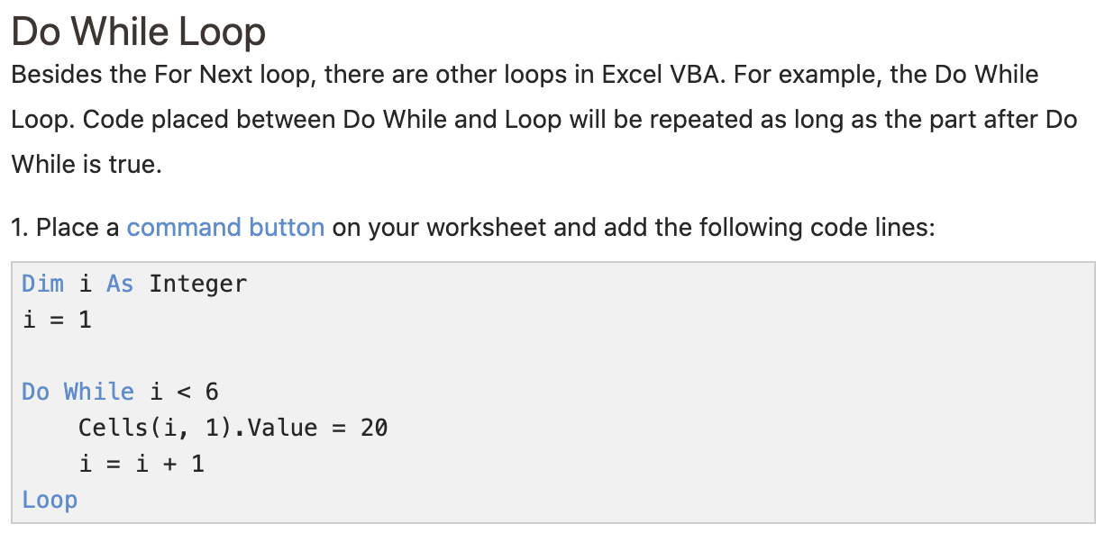
Do while loop

Slide 10
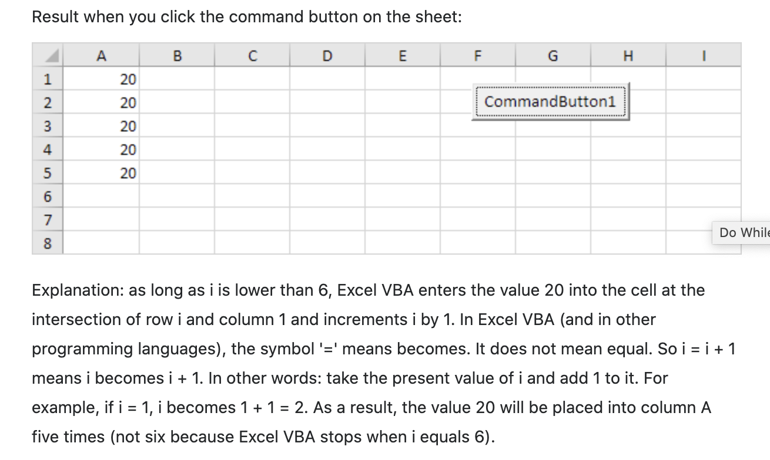
Do while loop

Slide 11
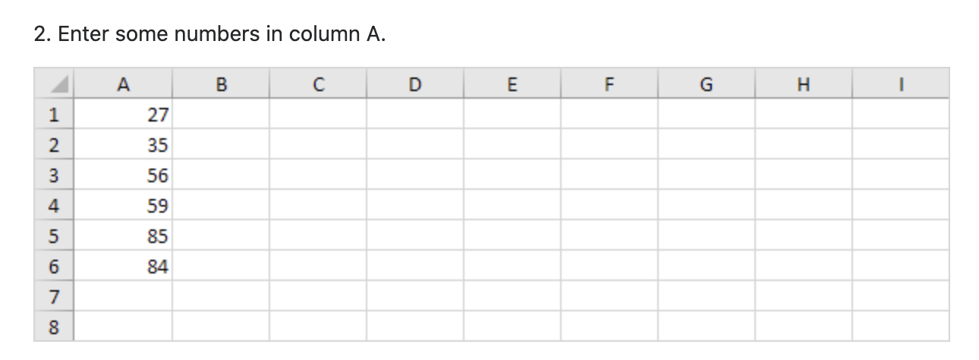
Do while loop

Slide 12
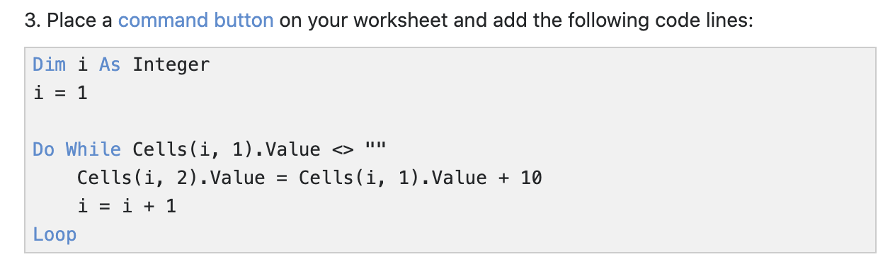
Do while loop

Slide 13
Do while loop

Slide 14
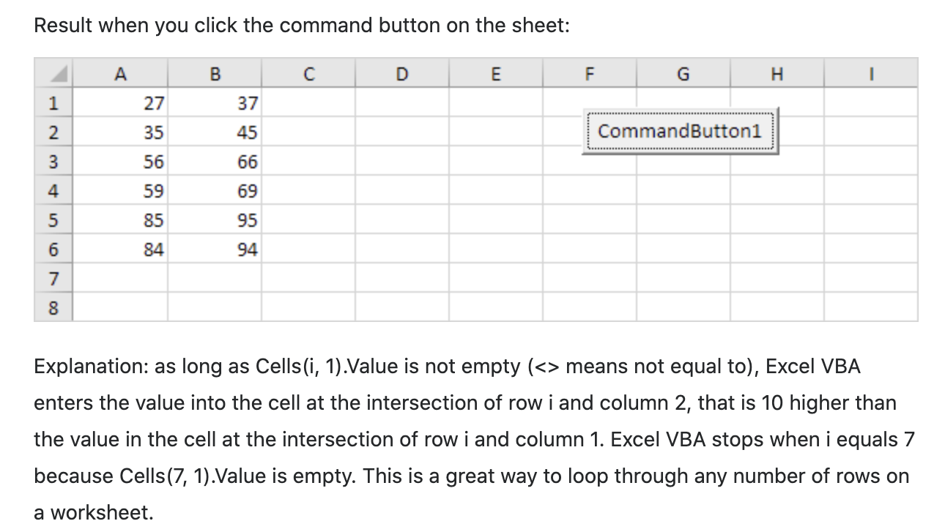
Do while loop

Slide 15
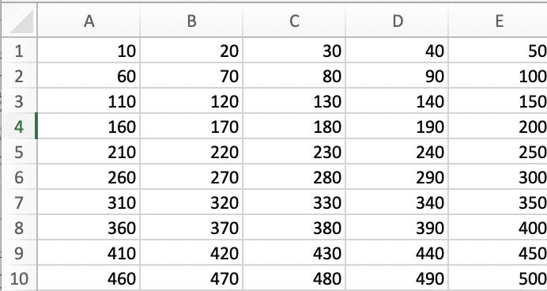
Exercise
Use the concepts learnt earlier on create this expected output
A1 – E1: 10 – 50 A2 – E2: 60 – 100 A3 – E3: 110 – 150 so on up till 500

